Slide 1
Results as of 9/12/14
I spent some more time looking over the death certificate data. In particular, take a look at the figure(s) below where I graph out the causal paths for ‘myocardial infarction’ by patient. I’m currently looking at modeling the data as Markov chains.
Perhaps I’m missing something, but I also just noticed that the set of all of the ‘disease or condition leading directly to death’ for the _gc rows are completely distinct from the set for all non _gc rows. Isn’t that our (100% accurate, 100% specific) classifier right there?

Slide 2
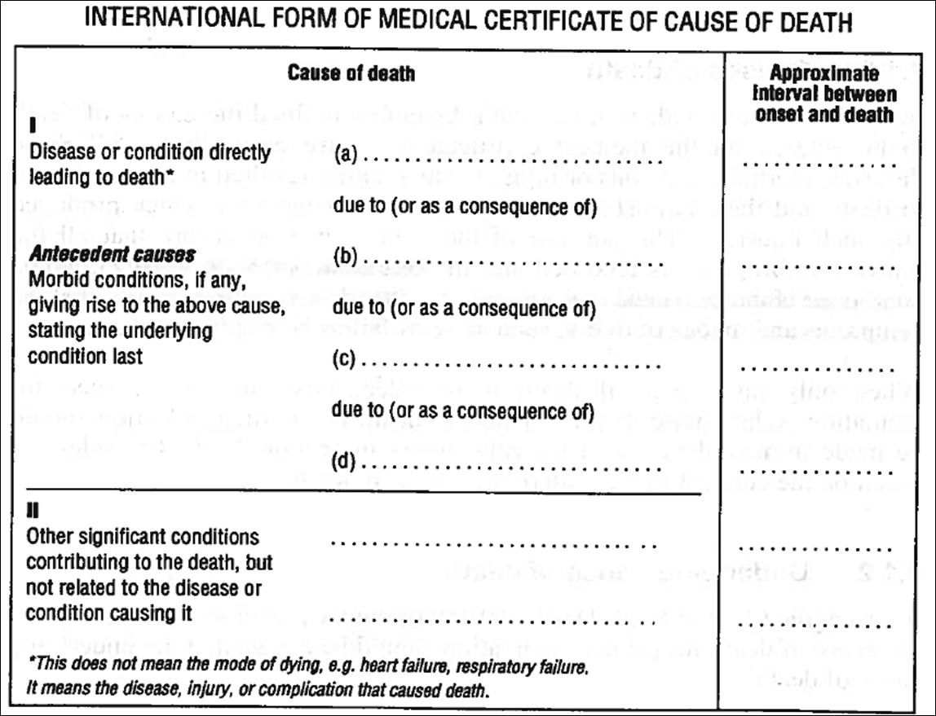
Information on the causes of death come from death certificates. In many cases we have not only the declared cause of death, but also the (supposedly ordered) antecedent causes that lead to death. These causes should be drawn from the list of International Classification of Diseases (ICD). The current set (ICD-10) has 91,737 such classifications. For example, E119: 1 Type 2 diabetes mellitus without complications
Pulmonary embolism | hours
Pathological fracture of Femur | 2 days
Secondary malignant neoplasm (femur) | 2 months
Malignant neoplasm of breast (nipple) | 1 year
Essential hypertension | 5 years
Obesity | 10 years

Slide 3
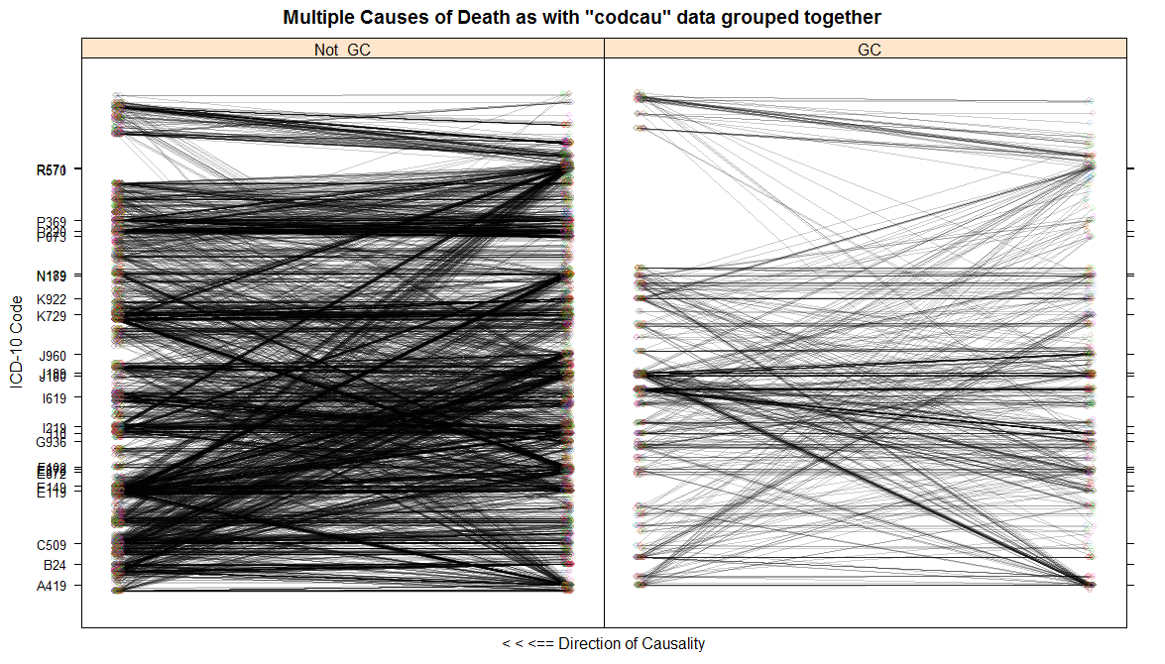
Ignoring the ordering of the ‘Antecedent cause’ data and just lumping it into one bucket for each patient results in the following figure. There may be some subtle differences but it is hard to tell.

Slide 4
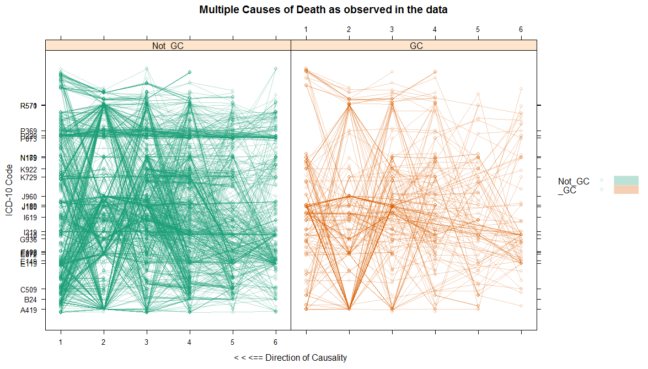
But now I break it out such that each line in a panel below represents the information for one patient. The x-axis shows from left to right the declared cause of death (1) to the ordered antecedent causes (2-6). Some of the most common ICD codes are shown on the y-axis. Again, there are some differences (e.g. deaths of newborns is always coded correctly), but it is hard to tell.
Cardiogenic shock
Preterm [premature] newborn [other]
Respiratory distress syndrome of newborn
Bacterial sepsis of newborn, unspecified
Sepsis, unspecified organism

Slide 5
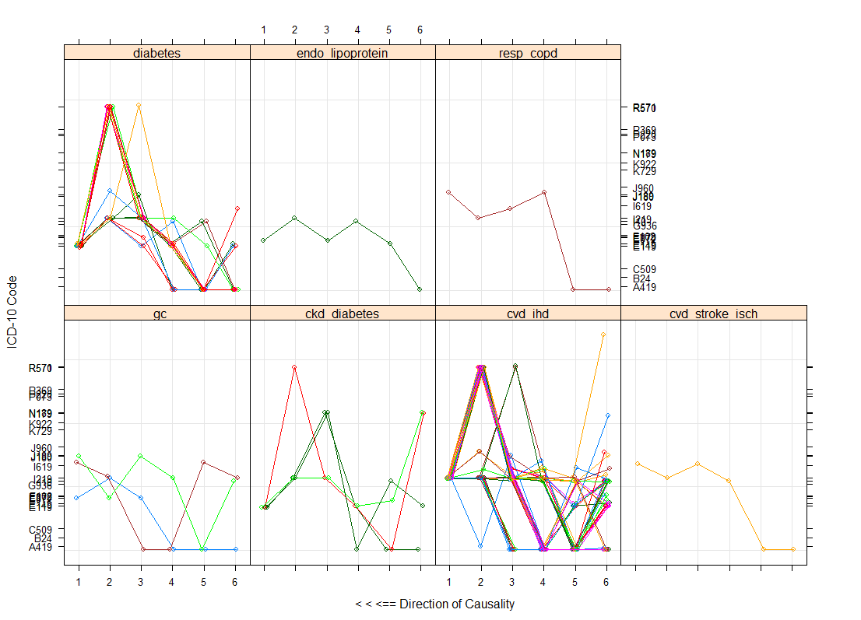
Zooming in on some specific examples. Here I picked all of the individuals who had ‘myocardial infarction’ in any part of their CoD chain, and then graphed their path, conditioning on the icd_name (shorthand for listed cause of death). Now there appears to be some definite patterns.

Slide 6
Here are examples of CoDs thought to be good:
sid icd_name age gender education cigsPerDay causeOrder MCD MCDfull
2040.1 2040 cvd_ihd 71 Female High School 0 1 I219 ? Non-ST elevation (NSTEMI) myocardial infarction | Subsequent STEMI & NSTEMI mocard infrc
2040.2 2040 cvd_ihd 71 Female High School 0 2 I219 ? Non-ST elevation (NSTEMI) myocardial infarction | Subsequent STEMI & NSTEMI mocard infrc
2040.3 2040 cvd_ihd 71 Female High School 0 3 R58 Hemorrhage, not elsewhere classified
2040.4 2040 cvd_ihd 71 Female High School 0 4 I219 ? Non-ST elevation (NSTEMI) myocardial infarction | Subsequent STEMI & NSTEMI mocard infrc
2040.5 2040 cvd_ihd 71 Female High School 0 5
2040.6 2040 cvd_ihd 71 Female High School 0 6 I10 Essential (primary) hypertension
561.1 561 cirrhosis 39 Female High School 0 1 K729 Hepatic failure, unspecified
561.2 561 cirrhosis 39 Female High School 0 2 K729 Hepatic failure, unspecified
561.3 561 cirrhosis 39 Female High School 0 3 K729 Hepatic failure, unspecified
561.4 561 cirrhosis 39 Female High School 0 4 Q445 Other congenital malformations of bile ducts
561.5 561 cirrhosis 39 Female High School 0 5
561.6 561 cirrhosis 39 Female High School 0 6
1059.1 1059 hiv_other 53 Male Primary School 0 1 B238 ? Human immunodeficiency virus [HIV] disease | Cytomegaloviral disease
1059.2 1059 hiv_other 53 Male Primary School 0 2 J969 Respiratory failure, unspecified
1059.3 1059 hiv_other 53 Male Primary School 0 3 G049 Encephalitis, myelitis and encephalomyelitis, unspecified
1059.4 1059 hiv_other 53 Male Primary School 0 4 B24 ? Human immunodeficiency virus [HIV] disease | Cytomegaloviral disease
1059.5 1059 hiv_other 53 Male Primary School 0 5
1059.6 1059 hiv_other 53 Male Primary School 0 6
860.1 860 neo_breast_cancer 68 Female Primary School 0 1 C509 Malignant neoplasm of breast of unspecified site
860.2 860 neo_breast_cancer 68 Female Primary School 0 2 J960 Acute respiratory failure
860.3 860 neo_breast_cancer 68 Female Primary School 0 3 C780 Secondary malignant neoplasm of lung
860.4 860 neo_breast_cancer 68 Female Primary School 0 4 C509 Malignant neoplasm of breast of unspecified site
860.5 860 neo_breast_cancer 68 Female Primary School 0 5
860.6 860 neo_breast_cancer 68 Female Primary School 0 6
855.1 855 digest_gastrititis 43 Male College or Higher 3 1 K290 Acute gastritis
855.2 855 digest_gastrititis 43 Male College or Higher 3 2 R571 Hypovolemic shock
855.3 855 digest_gastrititis 43 Male College or Higher 3 3 K922 Gastrointestinal hemorrhage, unspecified
855.4 855 digest_gastrititis 43 Male College or Higher 3 4 K296 Other gastritis
855.5 855 digest_gastrititis 43 Male College or Higher 3 5
855.6 855 digest_gastrititis 43 Male College or Higher 3 6 K721 Chronic hepatic failure
2533.1 2533 neonatal_preterm 0 Female Unknown NA 1 P220 Respiratory distress syndrome of newborn
2533.2 2533 neonatal_preterm 0 Female Unknown NA 2 T702 Other and unspecified effects of high altitude
2533.3 2533 neonatal_preterm 0 Female Unknown NA 3 P220 Respiratory distress syndrome of newborn
2533.4 2533 neonatal_preterm 0 Female Unknown NA 4 P072 Extreme immaturity of newborn
2533.5 2533 neonatal_preterm 0 Female Unknown NA 5
2533.6 2533 neonatal_preterm 0 Female Unknown NA 6

Slide 7
Here are examples of what these paths look like when the CoD is said to be a ‘garbage code’:
sid icd_name age gender education cigsPerDay causeOrder MCD MCDfull
630.1 630 _gc 35 Male High School 30 1 G629 Polyneuropathy, unspecified
630.2 630 _gc 35 Male High School 30 2 A419 Sepsis, unspecified organism
630.3 630 _gc 35 Male High School 30 3 J189 Pneumonia, unspecified organism
630.4 630 _gc 35 Male High School 30 4 G629 Polyneuropathy, unspecified
630.5 630 _gc 35 Male High School 30 5
630.6 630 _gc 35 Male High School 30 6
1870.1 1870 _gc 84 Female No Schooling 0 1 E86 Volume depletion
1870.2 1870 _gc 84 Female No Schooling 0 2 E872 Acidosis
1870.3 1870 _gc 84 Female No Schooling 0 3 R571 Hypovolemic shock
1870.4 1870 _gc 84 Female No Schooling 0 4 E86 Volume depletion
1870.5 1870 _gc 84 Female No Schooling 0 5
1870.6 1870 _gc 84 Female No Schooling 0 6
745.1 745 _gc 22 Male Primary School 8 1 J180 Bronchopneumonia, unspecified organism
745.2 745 _gc 22 Male Primary School 8 2 J960 Acute respiratory failure
745.3 745 _gc 22 Male Primary School 8 3 J180 Bronchopneumonia, unspecified organism
745.4 745 _gc 22 Male Primary School 8 4
745.5 745 _gc 22 Male Primary School 8 5
745.6 745 _gc 22 Male Primary School 8 6
1186.1 1186 _gc 1 Male Unknown NA 1 G919 Hydrocephalus, unspecified
1186.2 1186 _gc 1 Male Unknown NA 2 G049 Encephalitis, myelitis and encephalomyelitis, unspecified
1186.3 1186 _gc 1 Male Unknown NA 3 G919 Hydrocephalus, unspecified
1186.4 1186 _gc 1 Male Unknown NA 4
1186.5 1186 _gc 1 Male Unknown NA 5
1186.6 1186 _gc 1 Male Unknown NA 6
2209.1 2209 _gc 5 Male No Schooling NA 1 K922 Gastrointestinal hemorrhage, unspecified
2209.2 2209 _gc 5 Male No Schooling NA 2 A419 Sepsis, unspecified organism
2209.3 2209 _gc 5 Male No Schooling NA 3 J180 Bronchopneumonia, unspecified organism
2209.4 2209 _gc 5 Male No Schooling NA 4 E878 Oth disorders of electrolyte and fluid balance, NEC
2209.5 2209 _gc 5 Male No Schooling NA 5 K922 Gastrointestinal hemorrhage, unspecified
2209.6 2209 _gc 5 Male No Schooling NA 6 G934 Other and unspecified encephalopathy
2242.1 2242 _gc 85 Female Primary School 0 1 J181 Lobar pneumonia, unspecified organism
2242.2 2242 _gc 85 Female Primary School 0 2 E872 Acidosis
2242.3 2242 _gc 85 Female Primary School 0 3 J181 Lobar pneumonia, unspecified organism
2242.4 2242 _gc 85 Female Primary School 0 4 I219 ? Non-ST elevation (NSTEMI) myocardial infarction | Subsequent STEMI & NSTEMI mocard infrc
2242.5 2242 _gc 85 Female Primary School 0 5
2242.6 2242 _gc 85 Female Primary School 0 6 I10 Essential (primary) hypertension

Slide 8
The list of direct cause of death (i.e. the top line on the death certificate) for the _gc data is completely distinct from the list of non- _gc data!
> junk
[1] "M259" "G060" "K922" "J189" "I678" "E854" "Y094" "I679" "I10" "M798" "I698" "G809" "M623" "B948" "J180" "J985" "I269" "D376"
[19] "N179" "N40" "K750" "Y86" "K631" "C399" "C260" "G629" "I519" "K650" "M512" "I501" "G009" "I64" "B190" "J181" "I629" "E878"
[37] "V899" "G919" "A499" "A419" "D65" "A415" "K659" "K929" "M726" "N19" "B199" "I272" "G936" "Y349" "Y344" "Y248" "E872" "C785"
[55] "E86" "I500" "C80" "X599" "G822" "K639" "D181" "K319" "V878" "Y240" "I260" "V892" "J22" "Y169" "G824" "Y249" "D489" "I509"
[73] "X590"
> good
[1] "K709" "I608" "K550" "N189" "X954" "E119" "I219" "E112" "W100" "J440" "D440" "C187" "E141" "I110" "V049" "I639" "E149" "K704"
[19] "I609" "K729" "G409" "B238" "V099" "X955" "I615" "W172" "V299" "I619" "K721" "E117" "E146" "X958" "C921" "C920" "C910" "B208"
[37] "C509" "G312" "Q600" "C73" "B162" "K746" "B206" "I120" "K745" "C169" "C349" "I48" "E102" "C900" "C189" "K566" "K852" "K801"
[55] "M340" "K754" "C539" "G610" "Q605" "E116" "B207" "J09" "I634" "C97" "M069" "X680" "E790" "K703" "C859" "J36" "A199" "K318"
[73] "K350" "C19" "C56" "C819" "B212" "K562" "I258" "L89" "C924" "K859" "I420" "I691" "K255" "E840" "K359" "I718" "K403" "E142"
[91] "K851" "N200" "K20" "L984" "K805" "K810" "V496" "K578" "K820" "J849" "C64" "F03" "B182" "C241" "I011" "E46" "B200" "I618"
[109] "E668" "G122" "E115" "K264" "J449" "C716" "O97" "I330" "B690" "I614" "C911" "D693" "I259" "C61" "B205" "A09" "M321" "K701"
[127] "K743" "K565" "B230" "C220" "F102" "I099" "I119" "E109" "Q000" "E111" "I210" "K766" "V499" "K290" "I620" "C719" "N059" "I633"
[145] "P271" "Y400" "A162" "I638" "C629" "N709" "B181" "P220" "P523" "N039" "L031" "C029" "C384" "B209" "D430" "L100" "P239" "D383"
[163] "O996" "P369" "B203" "C835" "I671" "N390" "A86" "D431" "X994" "P209" "E441" "P269" "Q039" "Q897" "Q054" "Q043" "G419" "Q038"
[181] "P219" "Q390" "Q249" "Q439" "Q336" "P251" "E43" "Q419" "Q300" "P60" "D689" "F143" "C20" "N180" "I211" "B219" "I359" "Q211"
[199] "I350" "K420" "C609" "C07" "L023" "E669" "D381" "N202" "K254" "P293" "P240" "I803" "P529" "P072" "P285" "P368" "Q210" "E129"
[217] "p95" "O001" "E147" "X840" "V799" "X959" "Y044" "X098" "E059" "J439" "X090" "X080" "J441" "V798" "E145" "B24" "P201" "N258"
[235] "C919" "D610" "D696" "Q250" "I200" "B210" "Q040" "C459" "C845" "Q909" "N058" "Q430" "B012" "I059" "B59" "A150" "J841" "B218"
[253] "I352" "P960" "C833" "Q750" "G301" "Q019" "P073" "C538" "I429" "W874" "W870" "V041" "X760" "X049" "X096" "X044" "X099" "W876"
[271] "J219" "A049" "I422" "O150" "Q451" "P038" "E785" "X999" "F182" "E110" "B221" "P210" "P77" "X490" "X740" "E107" "X700" "P243"
[289] "X950" "B159" "G404" "Q893" "Q256" "P011" "D374" "O061" "O998" "O441" "O141" "O995" "O721" "O159" "O241" "O746" "O722" "O720"
[307] "O364" "Q793" "P021" "B204" "B909" "I090" "X640“
> junk %in% good # 0 of 73 junk codes are found in the good codes
[1] FALSE FALSE FALSE FALSE FALSE FALSE FALSE FALSE FALSE FALSE FALSE FALSE FALSE FALSE FALSE FALSE FALSE FALSE FALSE FALSE FALSE
[22] FALSE FALSE FALSE FALSE FALSE FALSE FALSE FALSE FALSE FALSE FALSE FALSE FALSE FALSE FALSE FALSE FALSE FALSE FALSE FALSE FALSE
[43] FALSE FALSE FALSE FALSE FALSE FALSE FALSE FALSE FALSE FALSE FALSE FALSE FALSE FALSE FALSE FALSE FALSE FALSE FALSE FALSE FALSE
[64] FALSE FALSE FALSE FALSE FALSE FALSE FALSE FALSE FALSE FALSE

